Slide 1

Performed by
Vladimir Zatsepin
Alexey Zamogilin
Ivan Tokarev
Mentors
Igor Barsukov
Dmitriy Nikitenko

Slide 2

Agenda
Meetings
Aims
System objects
Technologies
Architecture
Notification System
WebRTC
Features
Q&A

Slide 3


Slide 4





Meetings
Steps
1. Organization
2. Meeting
3. Results
1. Organization
2. Meeting
3. Results

Slide 5
Product aims are providing
convenient meetings organization
clear defined meeting’s tasks
audio and video connection
file sharing
opportunity to be more effective

Slide 6
Personal aims are
studying basic technologies and APIs of Java SE and Java EE
understanding basic principles of web applications development
learning concepts on relation databases
obtaining practical skills in team development

Slide 7
System objects
User (who?)
Meeting (what?)
Group (where?)
Calendar (how?)

Slide 8
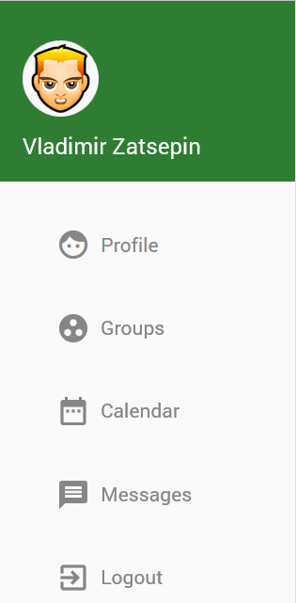

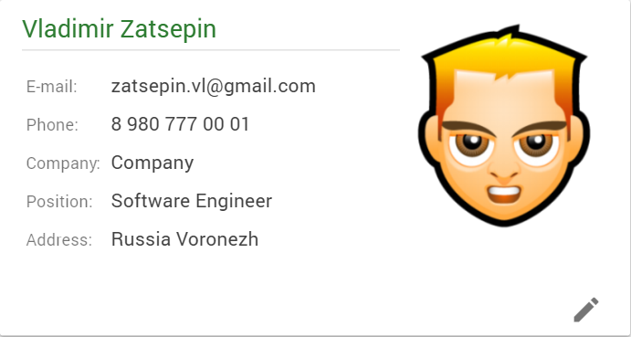
User

Slide 9
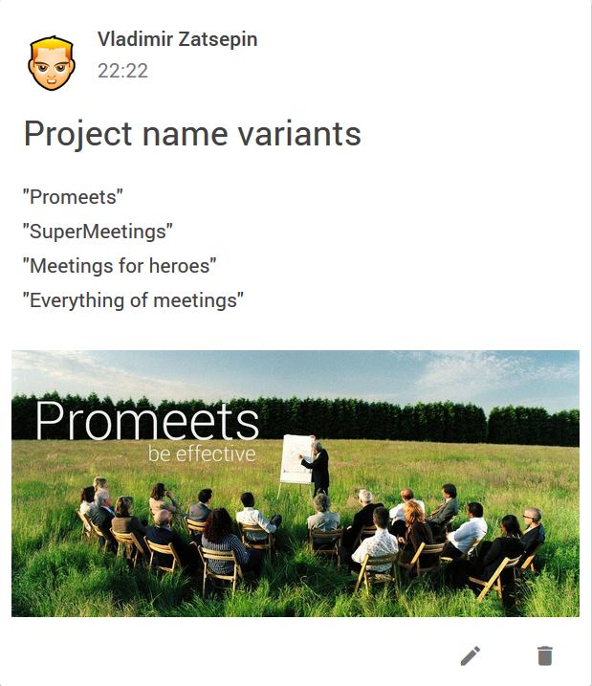
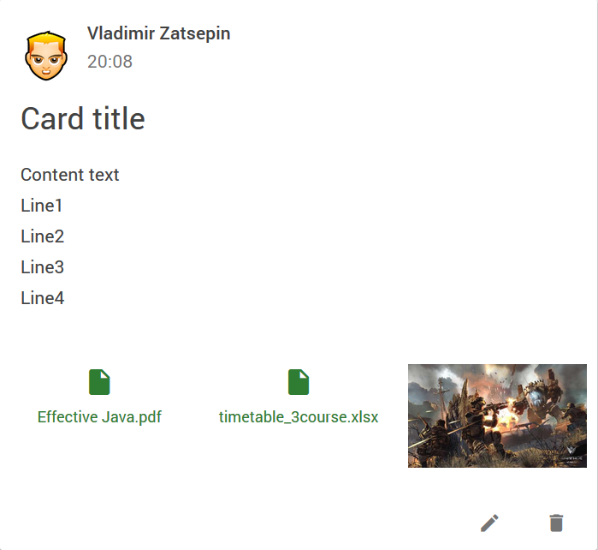
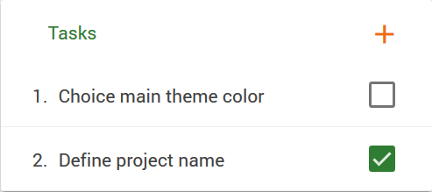
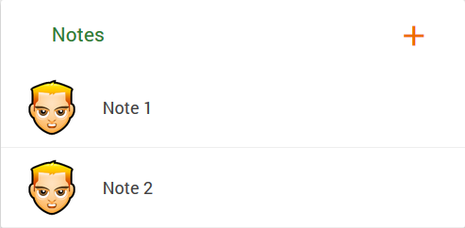
Meeting
Cards
Tasks
Notes

Slide 10
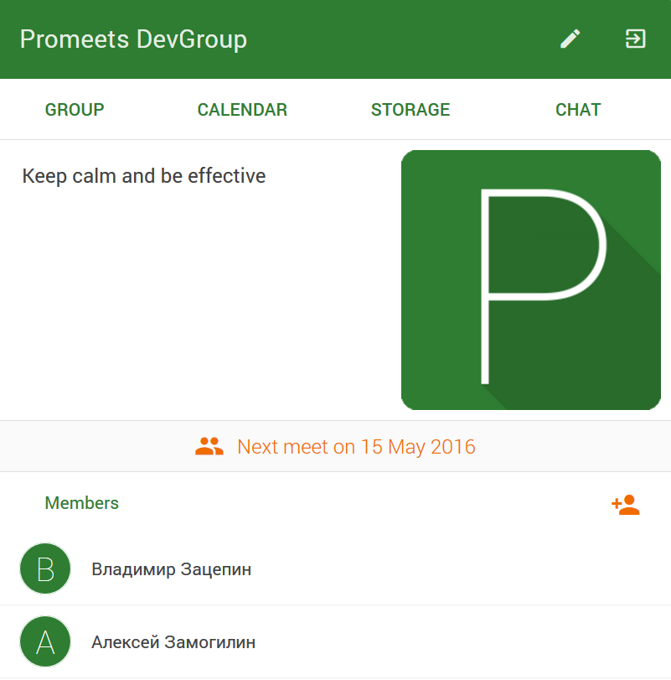
Group

Slide 11
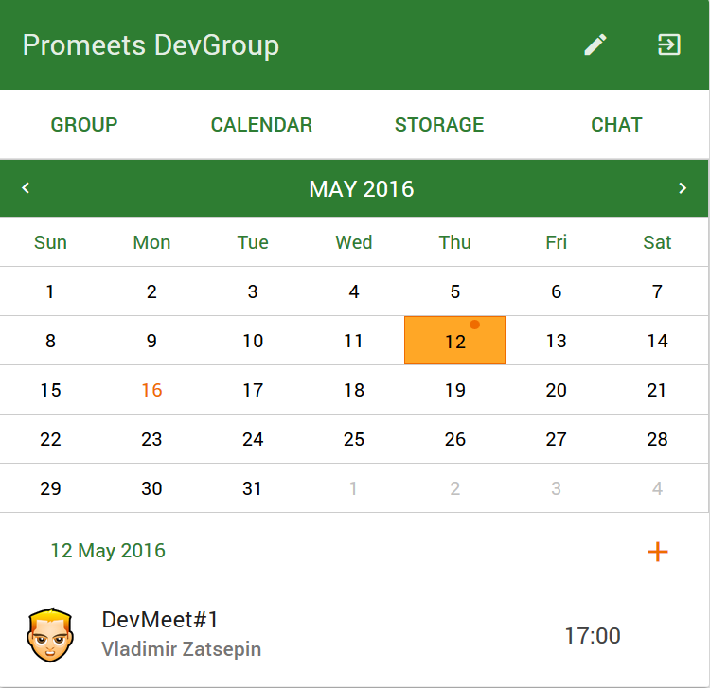
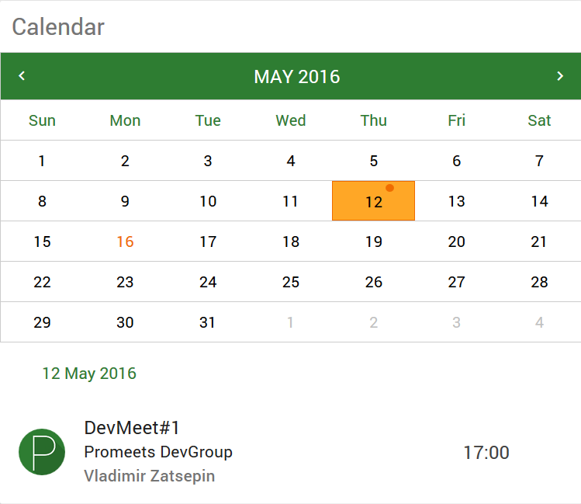
Calendar
Group
User

Slide 12
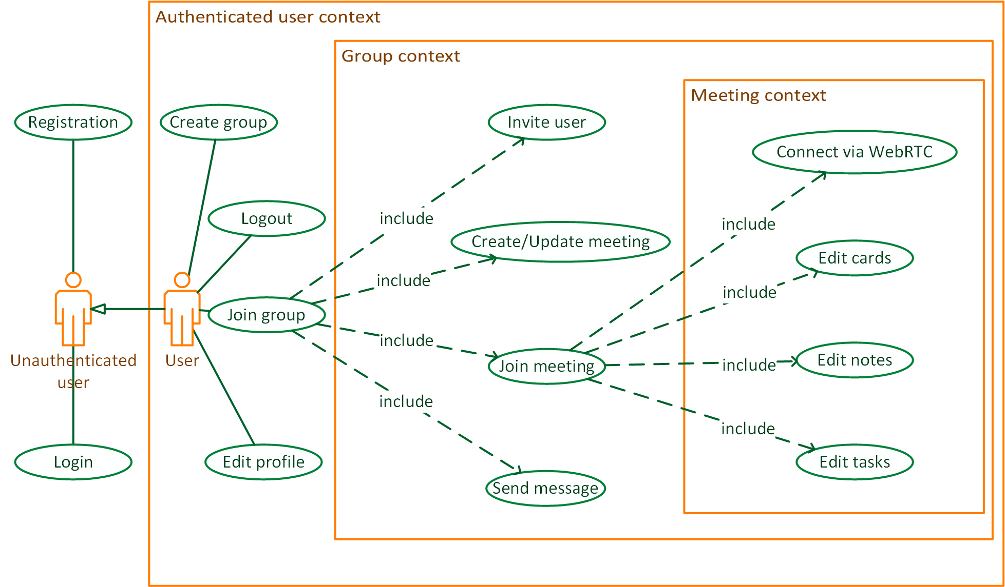
Use cases

Slide 13



Analogs

Slide 14










Technologies
Presentation layer
Business layer
Data access layer
Database
Spring Data
JPA
Spring Security

Slide 15
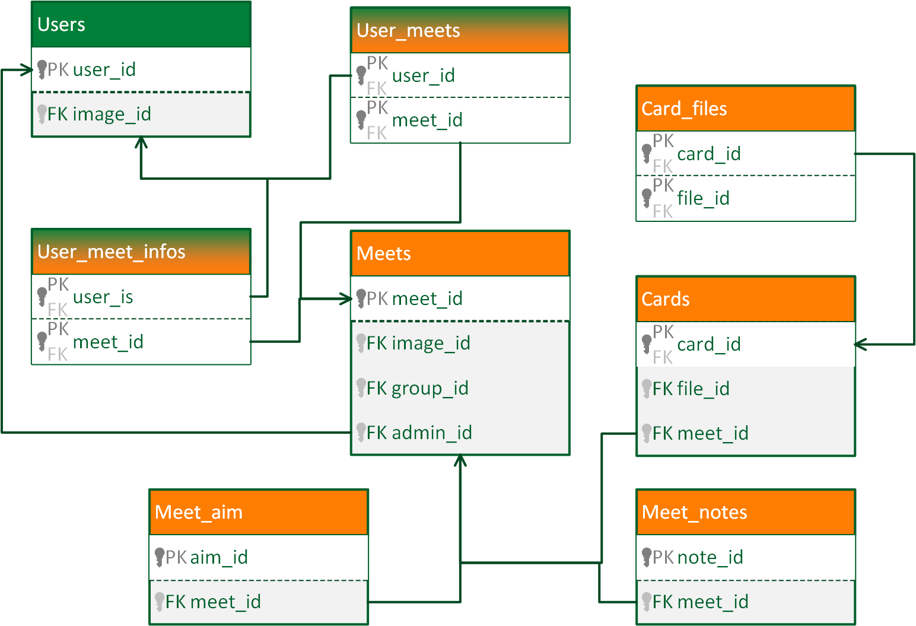
Database architecture. Meetings

Slide 16
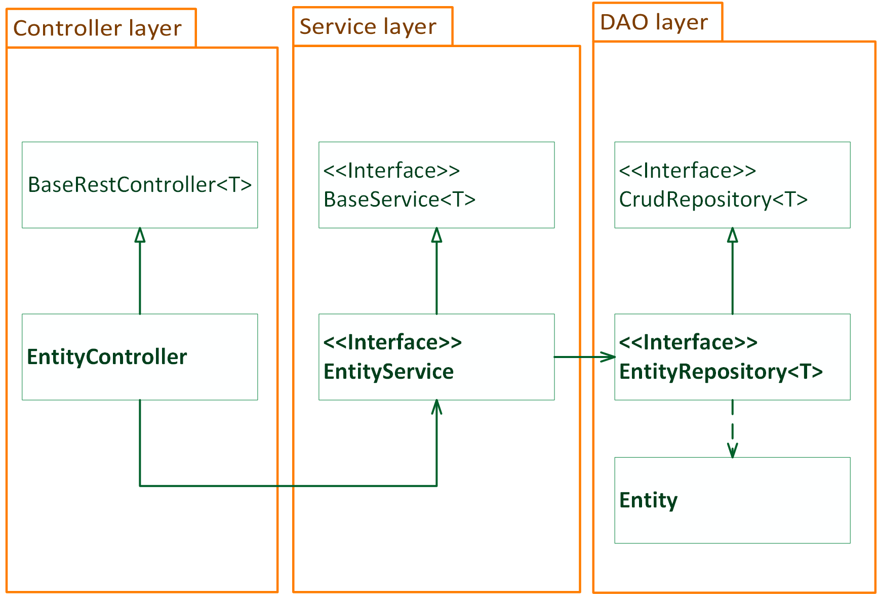
Server architecture

Slide 17
Notification system
Used for user notifications about:
invitation to the group
new message
new meeting or meeting updating
new card on meeting page
new note on meeting page
new task on meeting page

Slide 18
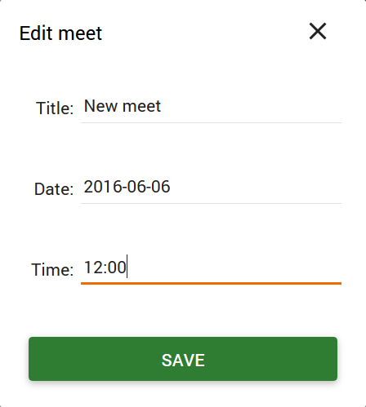

Notification system
User 1
User 2

Slide 19
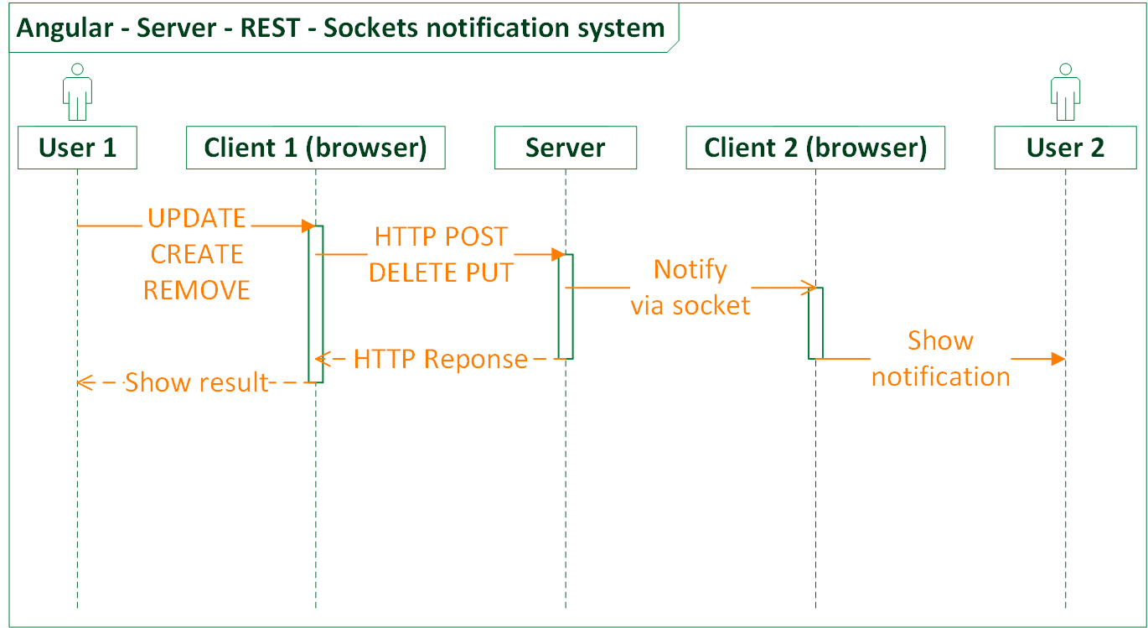
Notification system

Slide 20
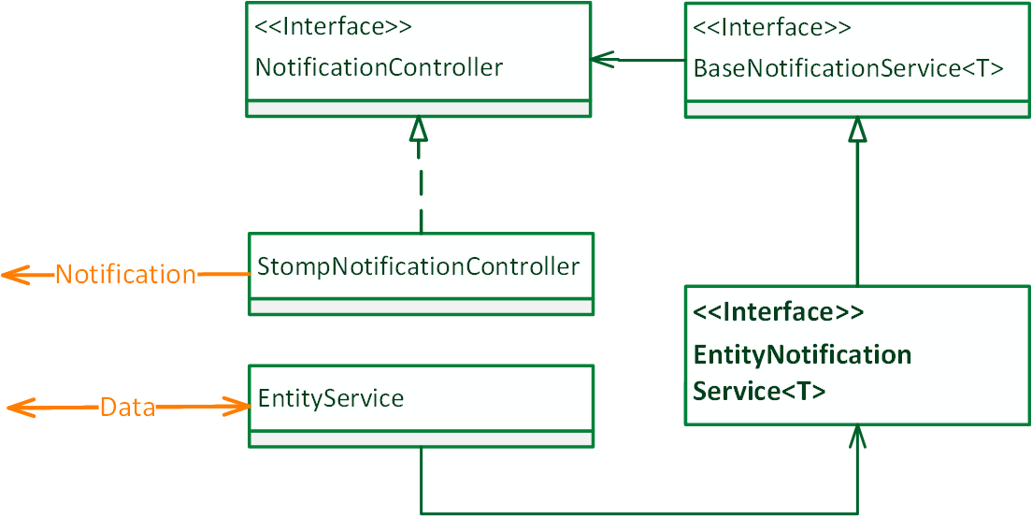
Notification system Server side

Slide 21
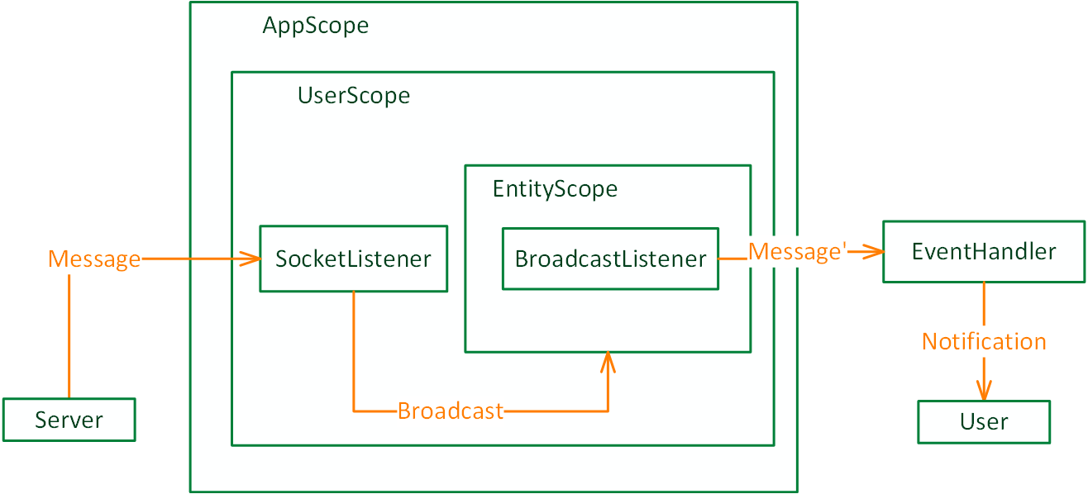
Notification system Client side

Slide 22
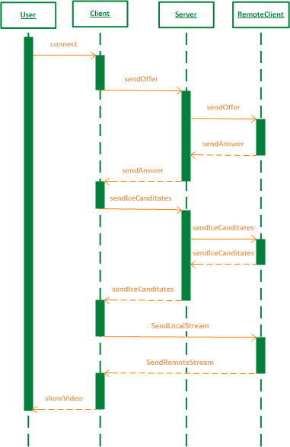
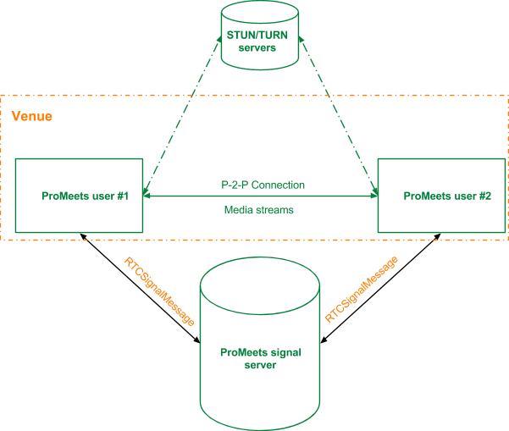
WebRTC

Slide 23
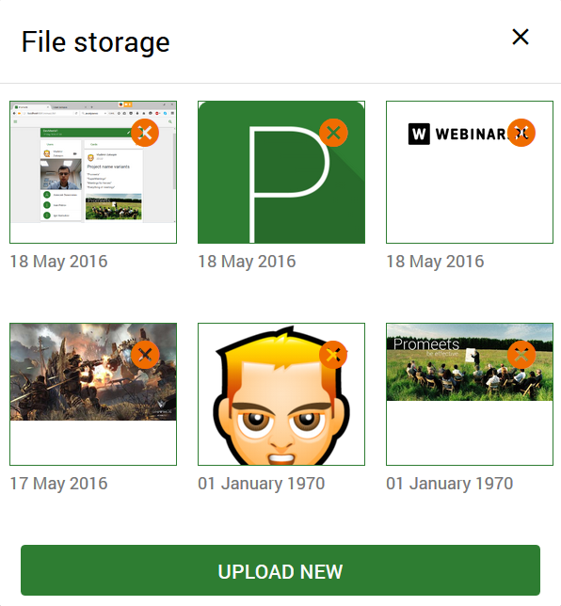
Features
Adaptive design
Audio and video connection on mobile phones
Uploading history
Images optimization

Slide 24
Q&A

Slide 25
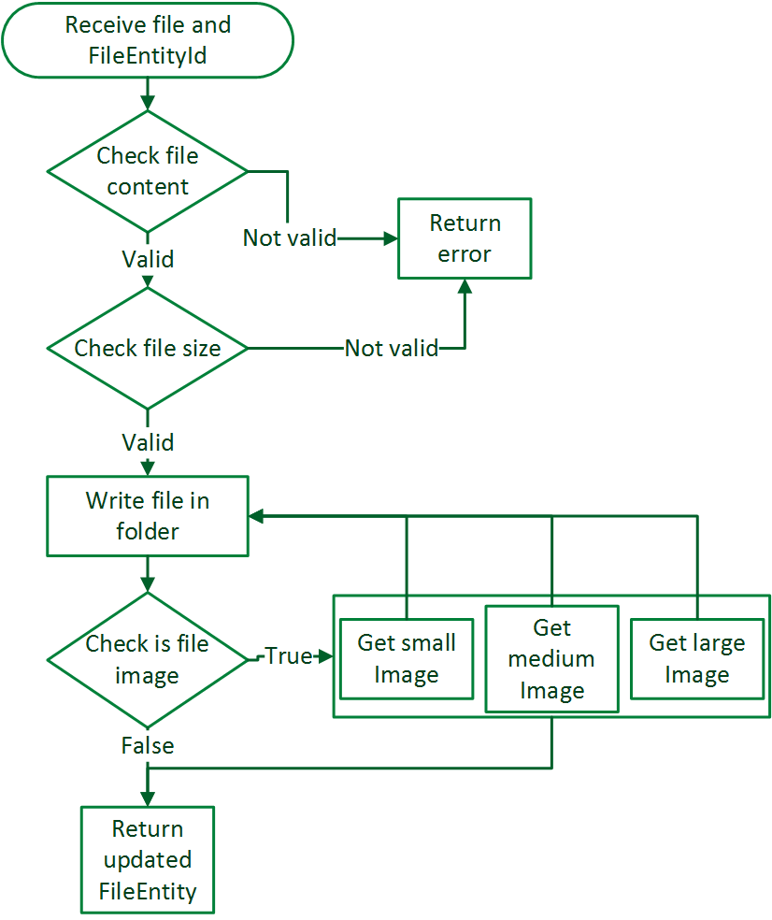
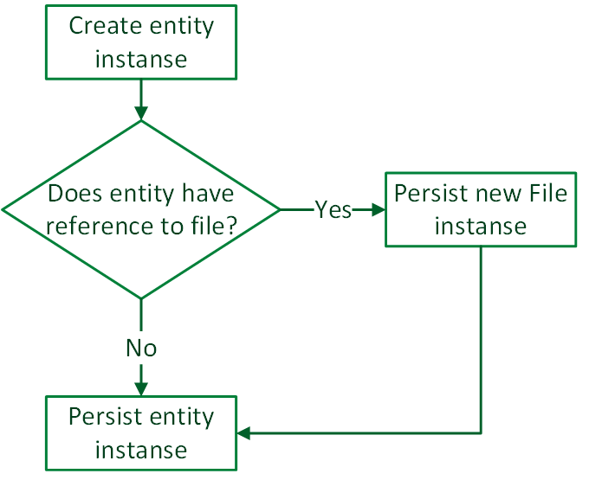
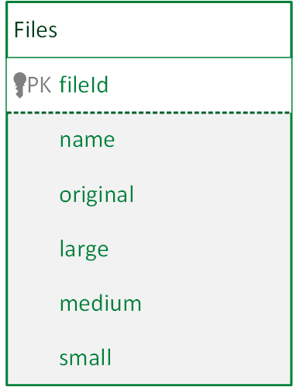
File uploading

Slide 26
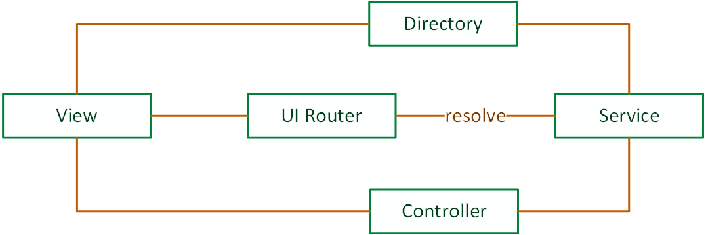
Client architecture

Slide 27
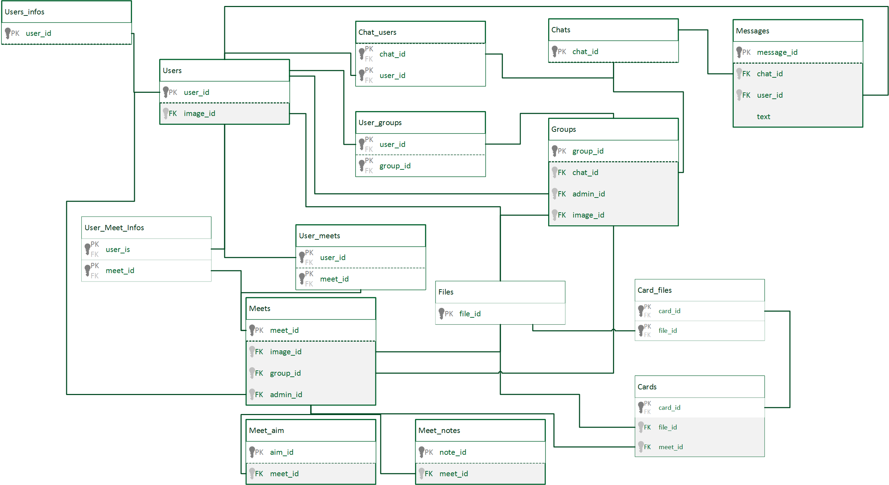
Database

Slide 28
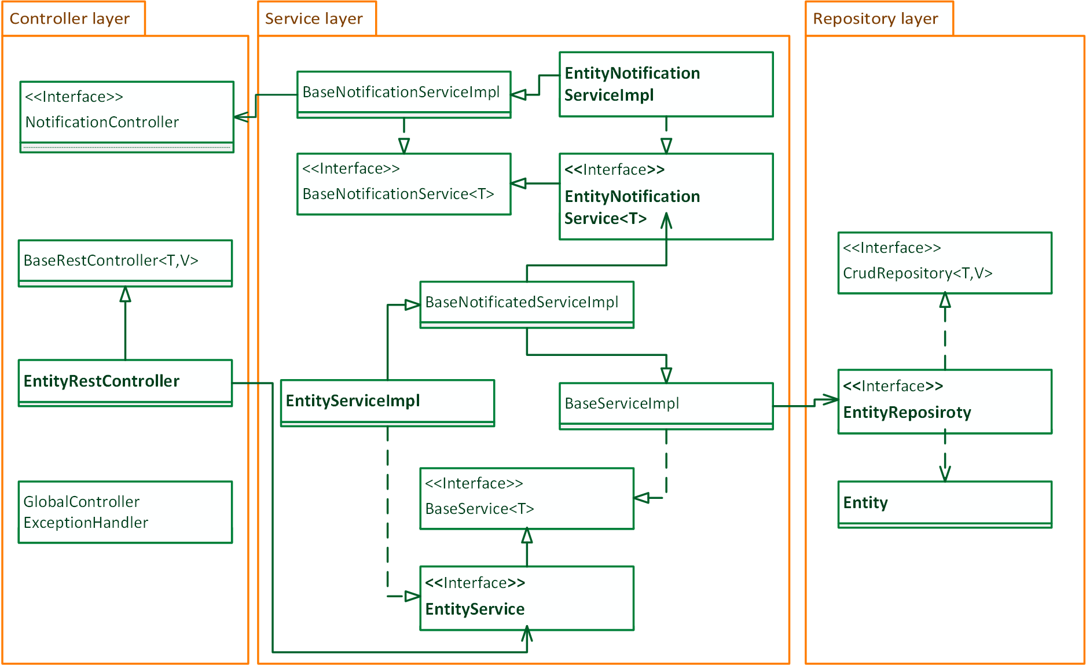
Server architecture

Slide 29
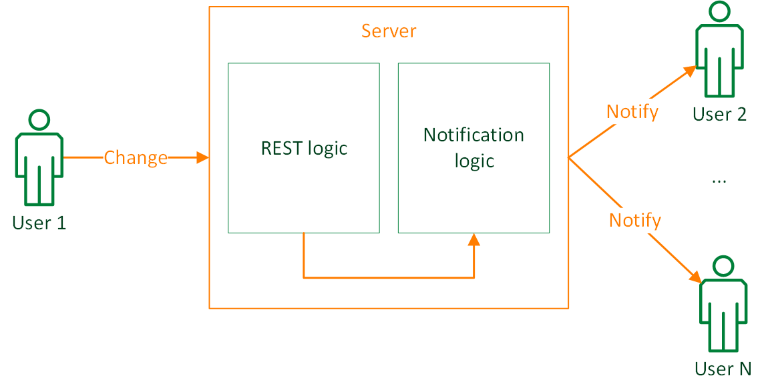
Notification system

Slide 30
WebRTC
Implementation

Slide 31
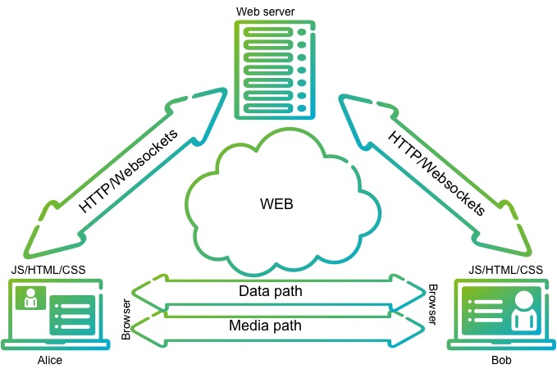
WebRTC
Architecture Overview

